Slide 1
Is becoming a NYC taxi driver worth it?
Arun Donti, Arthur Dooner, Jack Mercer, Aditya Nivarthi

Slide 2

Falling Profits
Competition such as Uber is taking market share

Slide 3

Medallions
Needed in order to operate a taxi
Prices falling with services like Uber and Lyft taking market share

Slide 4
Tracking Medallion Prices
Uber did not have an impact on the market until 2014
Tracked medallion sale prices from January 2014 to December 2016
Linear Trend line best fit
Best case is logarithmic, not really a great fit

Slide 5
How can we tell?
Variables
Equation
Using 2016 data
For One Year
R = Average Revenue from driving
G = Average Cost to drive and maintain car
M_{i} = Initial Medallion Cost
M_{f} = Medallion sale price
Equation from previous slide converted to years
Y = Years since January 2017
T = Total outcome
𝑇 = Y * (𝑅 −𝐺) −𝑀_{i} + 𝑀_{f}

Slide 6
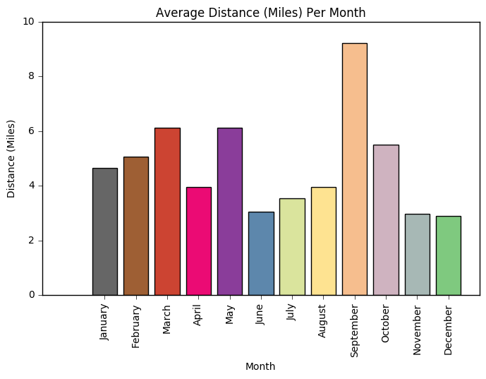
Trip Distance Data
2016
Get Average Trip Distance Per Month

Slide 7
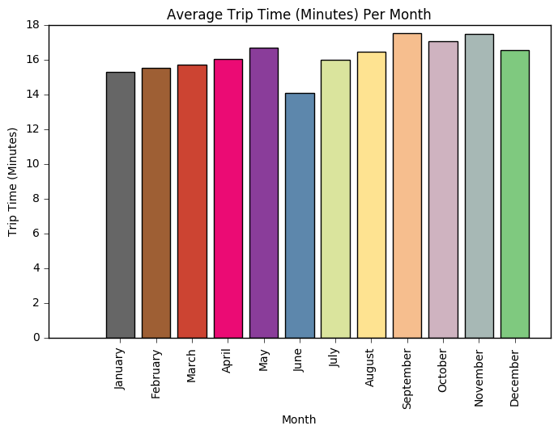
Time Data
2016
Get Average Trip Time Per Month

Slide 8
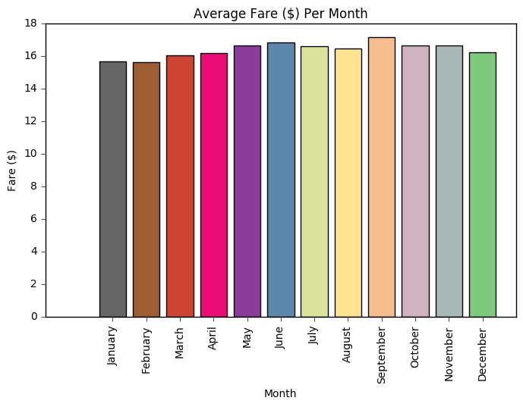
Fare Data
2016
Get Average Trip Fare Per Month

Slide 9
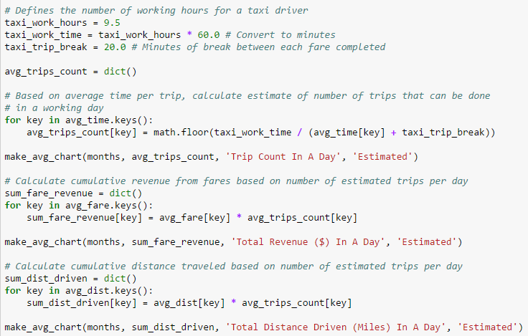
Estimating Trip Count and Revenue
9.5 working hours (10 minus food)
Tuned for 20 minute breaks at a time
Daily trip count based on hours, trip time, and break
Daily revenue based on average trip count and average fare
Part of daily cost is based on distance traveled

Slide 10
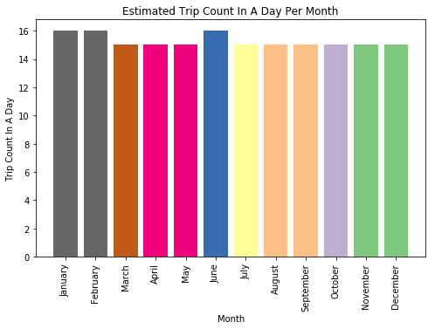
Estimated Daily Trip Count
Assuming 9.5 hour day with 20 minute breaks between trips

Slide 11
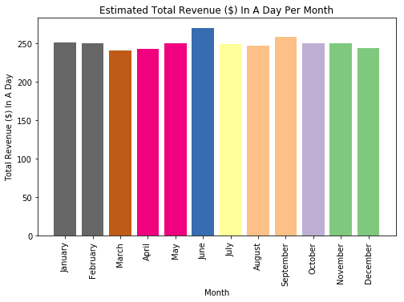
Estimated Daily Revenue
Assuming 9.5 hour day with 20 minute breaks between trips

Slide 12
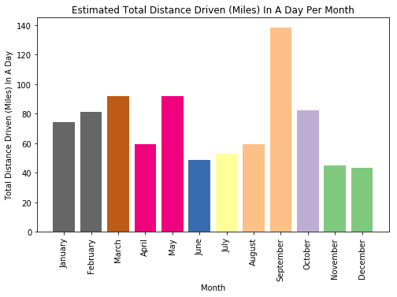
Estimated Daily Distance
Assuming 9.5 hour day with 20 minute breaks between trips

Slide 13
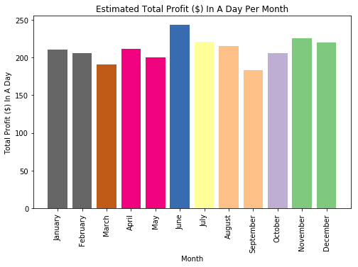
Estimated Daily Total Profit
Assuming 9.5 hour day with 20 minute breaks between trips

Slide 14
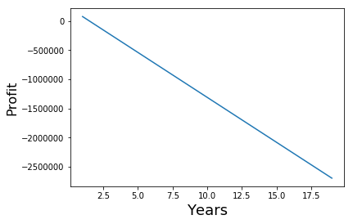

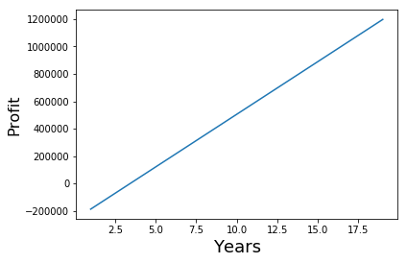
Estimated Profit Overall
Medallion Prices have been in free-fall, around April 2014 as $1,000,000, now $543,000 in December 2016
If we cap the medallions as being a minimum of $100,000, profit grows quickly, and our main requirement needs to be adjusted
Assuming 9.5 hour day with 20 minute breaks between trips
Total Yearly Profit Estimated at $76,993

Slide 15
Takeaways
The average NYC Taxi Cab driver makes $39K a year
This is not a recommendation that we show, this is better than best case scenario in many ways
Doesn’t factor in cost of living and other considerations, someone else would have to support you while you were building yourself up
Unless you start up and can get a medallion, there’s no way to get anywhere close to this profitability
Interesting discussion that can go much further

